Slide 1
Security
Network Security
  encryption
    ciphers
    one time pad
    DES
    Public Key
  authentication
  signatures
Notes:
In this lecture we look at the issues related to Network Security.
First we will study the various techniques that are used to encrypt data.
Next we look at some related issues such as authentication which involves trying to establish that who you are talking to is who they say they are and signatures which enable you to tell that a document is from the person it claims to be.

Slide 2
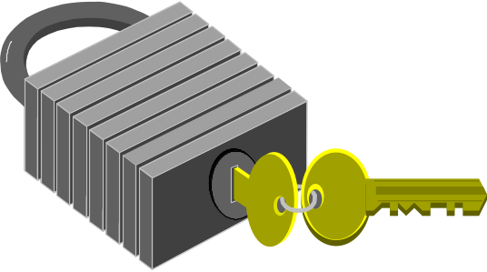
Encryption
Data protection
  transform data into a form readable only by the intended recipient(s)
  network feature
Keys
  Used as part of the encryption process
  management
  distribution
Notes:
The fundamental process by which security is achieved is encryption. Using some process the data is translated into an unreadable form. Unreadable, that is, to anyone except the person or persons you actually want to read it. This can be done simply for the reasons of secrecy on a person to person basis. It can also be a feature offered in a network where all data is automatically encrypted on entering the network and then decrypted on leaving the network thus offering secure transmission to the customers.
Typically encryption is thought of as placing the data in a box which needs a key to lock it up and also to undo it.

Slide 3
Cryptography
Plaintext
Ciphertext
Encryption
Encrypt function
Alice
Encryption key
Eve
Bob
Ciphertext
Plaintext
Decryption
Decrypt function
Decryption key
Notes:
In cryptographic terminology the message to be sent is known as the plaintext and the encrypted version is known as the ciphertext.
The boxes here show the general principle. The encryption process consists of taking the plaintext and applying some encryption function to it using a key.
The decryption process achieves the inverse of this by applying a decryption function to the ciphertext, using a decryption key, to obtain the original plaintext.
Note that, in general, it is not necessary for the encryption process to be the same as, or even the inverse of, the decryption process. Also the encryption and decryption keys need not be the same.

Slide 4
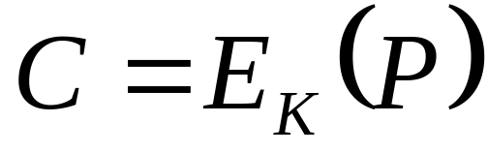
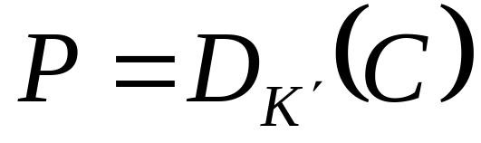
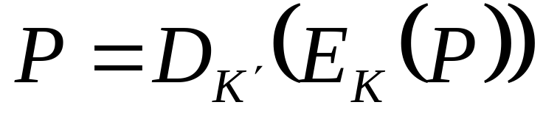
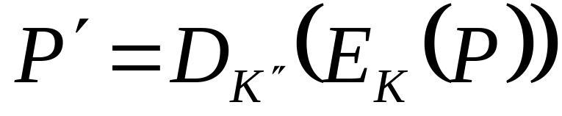
Representation
Encryption
Decryption
We need
and
To be very different from P
Notes:
This slide shows the traditional mathematical representation of the cryptography process. The encryption process is considered to be a function with the key K as a parameter. The decryption process is a second function with the key K’ as a parameter.
The third equation on the slide simply expresses the fact that encryption followed by decryption leaves the plaintext unchanged.
The final equation is one of a set of desirable properties which make code breaking difficult. If we decrypt a ciphertext with an incorrect key then we want the resulting plaintext to be ‘far from’ the correct plaintext. By ‘far from’ we mean that if a particular bit in the original plaintext is a one then the probability of that bit being one is 1/2 if K” is not the same as K’ and one if it is the same.

Slide 5
Types of Cipher
Secret Algorithms
  Only the intended recipient knows how to decrypt the cipher
  means that Alice and Bob must have met securely
Secret Key and Public Algorithm
  confidence if algorithm not broken
  still means that Alice and Bob must have met securely
Secret and Public Keys and Public Algorithm
  enables people who have never met to communicate securely
  problem of authentication
Notes:
Ciphers are broken up into a number of different types.
A secret algorithm cipher is one where the details of the encryption and decryption process are known only to Alice and Bob. In order for this to have happened they must have exchanged that information in a secure way and since we don’t have a secure network (yet) then they must have met in a secure environment.
A publicly known algorithm with a secret key known only to Alice and Bob is very similar. However, the main advantage is that the security of the algorithm can be tested and if it is not broken then they can have some confidence that the technique is a good one.
The final category is generally known as public key cryptography. This technique enables people who have not met to communicate securely. The issue of security is then replaced with one of authentication. How do you know that the person sending the message is who they say they are? Of course, if you had a shared secret you could check but then you would have had to meet.
For most network applications we assume E is known and that we are trying to see if anyone can work out D (or their keys if both E and D are known).

Slide 6
Code Breaking
Exhaustive search
  Try every Key until you get a sensible message
  Problem space grows exponentially with length of key
Back Door
  Alternative decryption process exists which depends on a small key
Known Plaintext attack
Chosen Plaintext attack
Statistical methods, Birthday attack
Notes:
Code breaking is a huge branch of mathematics and there are many techniques such as:
Exhaustive search: typically used in public key schemes where every key is tried in succession until the correct one is found. The first Internet code breaking of a 40bit key cipher was done this way. The problem grows exponentially with the length of the key so breaking an 80 bit key is way more than twice as hard as a 40 bit key.
Back door: This refers to an algorithm that can be reversed without using the correct decryption key in a way that requires a small, possibly one, attempts. Cryptographers often worry that government approved ciphers for the public have back doors built into them so that the security services can access any data they want to.
Known plaintext attacks: if you know the original plaintext of a particular message and the ciphertext it was translated to then it might be possible to work out something about the encryption process. This is one of the techniques that was used in breaking the Enigma cipher.
Chosen plaintext attack: this is the hardest to protect against. The cryptanalyst is allowed to choose P and be told C.
Statistical methods: If the encryption algorithm leaves some correlation between the plaintext and the ciphertext then it might be possible to look for those occurrences and deduce some properties of the cipher or the message.
Birthday attacks: a special class of attack based on the fact that the probability of two people out of twenty having the same birthday is about a half.

Slide 7
Substitution Ciphers
Define a permutation of the alphabet e.g.
  abcdefghijklmnopqrstuvwxyz
  mnbvcxzasdfghjklpoiuytrewq
Substitute corresponding letter in permutation to encrypt or decrypt
Problems
  each letter always appears as the same cipher-letter
  language has structure
  even quite small messages can be broken if contextual information is available
Notes:
One of the simplest codes is the substitution cipher which defines a permutation of the alphabet and then replaces each plaintext letter by its corresponding letter in the permutation. Thus, internet would become sjucojcu.
The problem with this form of code is not the size of the key space which is 26! but that the algorithm is weak. The weakness stems from the fact that language has structure. Letters appear at different frequencies in English, e is the commonest and then t, then o,a,n,i. If we have a large amount of ciphertext we can analyse the frequencies of occurrence of the letters and work out the permutation that was used.
Even a small amount of text may be broken if some contextual information is available. This might be simply knowing where the words start and end. It might involve knowing something about what the message might contain.
For example, the following coded message is sent to a stockbroker:
mtdd jdd zivzhj majxtm
Try and guess what the message might have said.

Slide 8
One Time Pad
Alice and Bob need a shared sequence of random binary bits
The message is expressed in binary form
Form an exclusive or of the message and the random sequence
Discard the sequence
This is the only known provably secure code
If you re-use the sequence the cipher is compromised (subject to statistic attack)
Need a key as long as the data
Notes:
The one time pad is a simple code. Alice and Bob need to share a random sequence of binary bits. When the message has been expressed in binary form the ciphertext is formed from an exclusive or between the message and the random sequence. The sequence must then be discarded and never re-used for another message.
This is the only known provably secure encryption algorithm. To see this consider sending a single bit message perhaps corresponding to 1=yes, 0=no. The ciphertext seen by eve is 1, the random sequence (of 1 bit) was either 1 or 0 with equal probability so both possible messages are equally likely. The security of the code now rests on the secrecy of the random bit sequence. To see that re-using the random bit compromises the code consider sending a second message of the same form. The second ciphertext is the same (different) as the first one. Since the random bit was the same we can deduce that the message was the same (different) as the first one. In many cases this would be enough.
The major problem with using this code is that the random bit sequence is as long as the data. To put it another way, the key is the same length as the data. So, to send large amounts of data we would need large amounts of shared random bits.
The real work of cryptographers is devising codes which are secure but have a key which is small.

Slide 9
Transposition and Substitution
Decoder
Encoder
P-Box
S-Box
Notes:
Modern cryptographic algorithms still rely on the basic operations of permutation and substitution. These two operations are illustrated on the slide.
The P-Box (permutation) is a one to one reconnection of the inputs to the outputs. This can be performed in hardware very quickly.
The S-Box (substitution) consists of a decoder stage which interprets the input lines as a binary number and makes the appropriate output line go high, followed by a P-Box and then a decoder which produces the binary representation of the number of the line on the output side of the P-Box which is high.
Complex ciphers can be formed by taking combinations of these two basic elements. Each of the basic elements is configured in some way by the key that specifies the cipher.

Slide 10
DES
Data Encryption Standard
  developed by IBM
  64 bit block cipher
  Iteration involves swapping and XOR
  key length 56 bits
  still a monoalphabetic substitution cipher
  electronic codebook mode
Initial Transposition
Iteration 1
{
Key
Iteration 16
32 bit swap
Inverse Transposition
Notes:
The diagram shows the architecture of the Data Encryption Standard algorithm developed by IBM and adopted for use by the US government. It codes 64 bit blocks of data by passing them through the sequence of operations shown. The initial transposition and the final transposition are inverse of each other. The heart of the cipher lies in the function applied in each of the 16 iterations. Each iteration contains some bit swapping and also passing though a sequence of S and P boxes controlled by the Key which is 56 bits long.
DES is still a monoalphabetic substitution cipher. For a given key there is a unique output for each input and if it is used like this (electronic codebook mode) the cipher can be subverted even without breaking it. This can be done by reordering the 64 bit blocks to create an equally valid message. Of course, the original message would have to have been set up in such a way that this makes sense.
Even if the subversion attack was not possible the cipher would be weaker against a known plaintext attack as eight character sequences could be built up.

Slide 11
Cipher Chaining
Avoid codebook problems
  provide feedback in the encryption process
  output depends on a longer history of 64 bit blocks
  need an initialisation vector (IV) to start the process off
P_{n}
E_{K}
C_{n}
#
1 block delay
Notes:
Chaining is a general way to get around the problems of ciphers working in electronic codebook mode. In order to break the association between a given plaintext block and its cipher block, the cipher is embedded in a feedback loop which also contains an additional exclusive or gate (marked # in the slide). The nth plaintext block is first exclusive ORed against the previous ciphertext block and the result is then encoded to produce the nth ciphertext block. All that is needed now to complete the specification is an initialisation vector (IV) to feed in to the exclusive or gate as the first plaintext block arrives. The complete cipher is then specified by the Key and the IV.
The decryption sequence can easily be constructed by writing the functional definition of the feedback loop:
From which we can solve for the plaintext as:
where D_{K’} is the decryption process for E_{K}.
This is fine for encrypting files where all the data is known in advance but is not much good for encrypting slow or streamed traffic.

Slide 12
Byte feedback mode
C_{n-8}
C_{n-7}
C_{n-6}
C_{n-5}
C_{n-4}
C_{n-3}
C_{n-2}
C_{n-1}
Shift register
E_{K}
One byte delay
Select leftmost byte
P_{n}
C_{n}
#
Notes:
When the data arrives slowly, as from a telnet terminal, we need a scheme which can allow single bytes to be encrypted while retaining the security of a larger cipher.
This is achieved using a byte feedback mode. The fundamental plaintext and ciphertext blocks P_{n} are now in units of single bytes. The current plaintext byte is exclusive ORed against the part of the 64 bit encryption of the previous eight ciphertext blocks.

Slide 13

Public Key Cryptography
Introduced in 1976 by Diffe and Hellman
Encryption process E_{K}
Decryption process D_{K’}
E, D and K are public
K’ is private
Public data
Alice = K_{A}
Bob = K_{B}
Alice data
K_{A}
Alice
K’_{A}
Bob
K’_{B}
E_{KA}(P)
Notes:
Public key cryptosystems were first described in 1976 by Diffe and Hellman. They rely on having publicly known algorithms together with a public and a private key.
Suppose Bob wants to send a plaintext P to Alice. First he requests Alice’s public key from a server. Next he encrypts P using the known algorithm E and Alice’s key and sends the resulting cipher text to her. Since the ciphertext was obtained using Alice’s key she and only she can decrypt it to obtain the original plaintext.
This technique relies entirely on the difficulty of deducing K’ given the knowledge of K. There are no known algorithms for which this difficulty has been proven so the security of public key systems is largely a matter of faith.

Slide 14
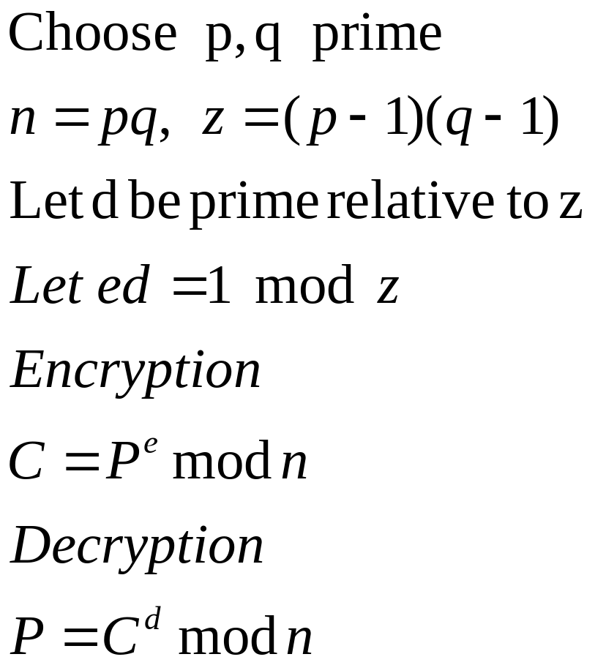
RSA
named after the inventors Rivest, Shamir and Adelman, 1978
Notes:
RSA is an algorithm believed to be suitable for public key cryptography.
First we choose two large primes p and q and define two numbers n and z as shown in the slide. We then choose a number d which is prime relative to z (i.e. It is not a factor of z) and find the number e as defined in the slide.
The pair (e,n) is the public key and the pair (d,n) is the private key. The encryption and decryption functions are shown in the slide.
The difficulty in breaking the cipher comes from the difficulty in factoring large numbers such as n. There is no known ‘fast’ (polynomial time) algorithm for finding p and q given n. If there was we could quickly deduce d given e and z.

Slide 15
RSA example
p=19, q=13 => z=18*12=216 and n=19*13=247
choose d=7
want 7e=1 mod 216 gives e=31 (Euclid algorithm, see http://users.erols.com/eweidaw/applets/EuclidExtension.html)
Let P=3, P^{e} mod 247 = 185
P = 185⁷ mod 247 = 3
In practice need to use special algorithms to handle very large integers
Notes:
In this slide we show a particular example of the RSA algorithm. Even using small numbers for p and q we rapidly generate some very large numbers to handle like 3^31 is needed to encrypt the plaintext represented by the number 3.
This details of this example are contained in the spreadsheet lecture14.xls which is available on the website. Note that to calculate the number e we need to use Euclid’s extended algorithm ( a Java applet can be found on the website quoted on the slide).
In practice these sorts of cipher have to use specially designed algorithms that can handle very large (hundreds of digits) integers.

Slide 16



Authentication
Suppose I have established a secure link
How do I know the person at the other end is who they say they are?
Man in the middle attack
Need some shared secret information or a trusted third party
Bob
Alice
Notes:
Even if we accept that we can establish communication over a link which is ‘sufficiently’ secure we are still left with a big problem. How do I know that the communicator at the other end of the line is who they/it claim to be? How do I know that they are not just pretending to be the intended recipient.
The classic example of such a problem is known as the ‘man in the middle attack’. Here a third party cuts the link in half and sits in the middle. By pretending to be Alice to Bob and to be Bob to Alice they can discover the entire conversation.
The only real way out of this dilemma is for Alice and Bob to have some shared secret information. In the setup phase they can then exchange messages which are encrypted using the onetime pad using the secret information as the key. Since the onetime pad is unbreakable the eavesdropper cannot do anything with this part of the conversation. While this is a good solution it is not always practical since Alice and Bob must have met at some point in order to exchange the secret information.
In order to enable people who have never met to authenticate each other there is a technique that is proposed which is the use of trusted third parties. These would have previously established the authenticity of users and institutions registered with them. When two such parties wish to communicate they both speak independently to the third party who establishes their authenticity.

Slide 17
Authentication protocols
In practice , protocols tend to use the secret information as a master key to enable them to set up a session key that is only used for a particular conversation.
1
A
2
RB
3
Bob
Alice
K(RB)
4
RA
5
K(RA)
Notes:
In this slide we show an authentication protocol involving five stages.
In the first stage Alice announces herself to Bob.
In the second stage Bob send an unencrypted random number to Alice.
Next, Alice returns the random number encrypted with their secret key. At this point Bob is satisfied that Alice is who she claims to be.
The fourth stage involves Alice sending a random number to Bob.
Finally Bob returns the random number encrypted with the secret key.
Both users can now be confident that the other party is authentic.

Slide 18
Signatures
Legal and security issues
  to establish authenticity of documents
  to establish the author
Need a method of digital signing
  document not necessarily encrypted
  signature must be difficult to forge
    hence base on encryption techniques
Notes:
It is not difficult to imagine legal and security reasons why we would want to be able to establish the authenticity of a document and its author. Both are needed as we want to establish that X wrote this document and exactly this document (i.e. it has not been altered).
In order to do this we need some method of digitally signing a document even if we have no need to encrypt the document itself. Clearly, the signature has to hard to forge so it is not surprising that the techniques are based on the use of cryptography.

Slide 19
Public Key Signatures
If E(D(P))=P as well as the usual D(E(P))=P
  use a decrypted copy of the plaintext as the signature
  message = P, signature = D(P)
  remember each user has a secret key for D
  only need to send D(P) since E is public
  D(P) can be encrypted with Bob’s key in the normal way for secure transmission and to prevent plagiarism
Notes:
Under normal use a cipher only has to have the property that D(E(P))=P. If it also has the property that E(D(P))=P then it can be used as a digital signature. The signed document simply corresponds to the decryption process having been applied to the document so D(P) would be the signed version of document P. This is so since the decryption key is secret and unique to each user so only the sender can produce D(P). If the signed message is sent unencrypted then everyone can read it and can verify who sent it by using the public key for the encryption process (which is being used to decrypt the signed file). At this stage it is still possible for plagiarism to occur. If the message was an original piece of work being submitted to publishers then it could be read and re-signed by anyone using their secret key. In order to prevent this the signed message is sent to the intended recipient encrypted with their public key.
This whole process mixes up the two requirements for authentication and secrecy. Let us now consider a scheme whereby unencrypted documents can be authenticated.

Slide 20
Message Digests
A message digest is a fixed length piece of text which depends on the original message
the digest is then signed as discussed in the last slide
MD5 is an internet standard, RFC 1321
  breaks up the input message into 512bit blocks
  pads last block and adds message length information
  mixes each 512 block with a 128 bit buffer
  produces a 128 bit digest
Many messages correspond to each digest but digest space is large so probability is small
Notes:
In order to produce something more akin to a real signature, i.e. a small piece of text at the end of a message, message digests were introduced. The digest is a fixed length piece of text which depends in a complicated way on the original message. The size of the digest also needs to be sufficiently large that the probability of two messages having the same digest is small. In order to produce the digital signature the digest is encrypted using the author’s private key and the decryption function as explained in the last slide.
One such message digest, used on the internet, is MD5 and is specified in RFC1321. The message is broken up into blocks of 512 bits and the last block is padded and has message length information added to it. Each of these 512 bit blocks is then mixed with a 128 bit buffer in a complicated way. At the end of this process the contents of the buffer define the message digest.

Slide 21
Next Lecture
Domain Name System
Simple Network Management Protocol
Notes:
In the next lecture we will discuss the domain name system which translates named addresses such as www.aston.ac.uk into IP addresses.
We will also look at the simple network management protocol SNMP.

